Slide 1
Convolutional Neural Networks
Amal Joseph
Machine Learning Engineer @ Arcesium

Slide 2
Overview
How do we see?
CNN and Visual Cortex
Convolutional Neural Networks
Image representations - Pixel (Grayscale Image and RGB Image)
CNN Architecture
How does Convolution works?
Pooling Layer (Max Pooling and Average Pooling)
Flattening and Fully Connected Layer
Non- Linearity - ReLU
CNN Pipeline
Stride and Padding
Application of CNN
Advantages of CNN
Hands-on

Slide 3
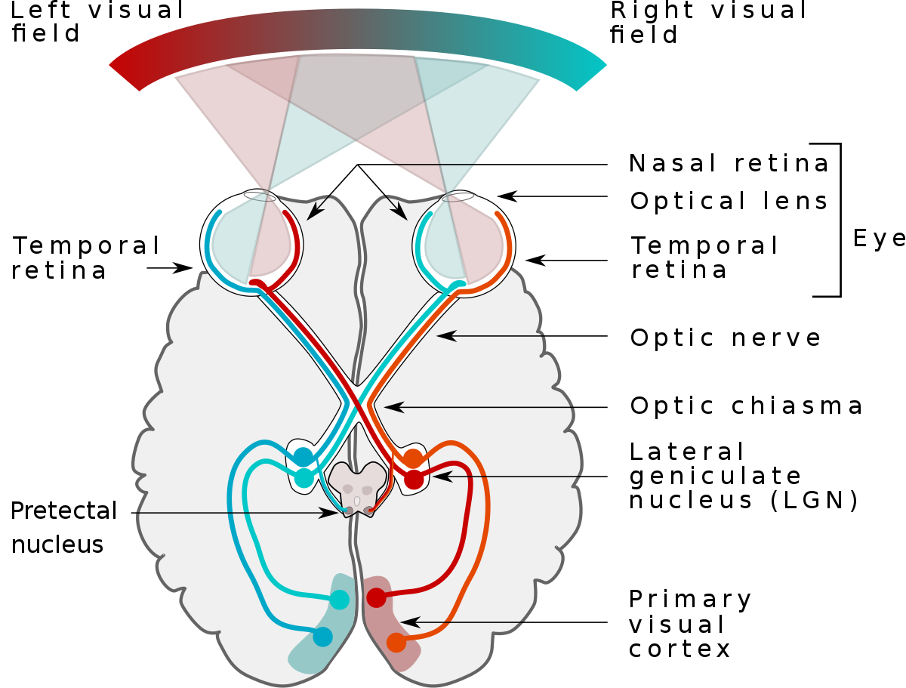
How do we see?
When light hits the retina (a light-sensitive layer of tissue at the back of the eye), special cells called photoreceptors turn the light into electrical signals.
These electrical signals travel from the retina through the optic nerve to the brain. Then the brain turns the signals into the images you see.

Slide 4
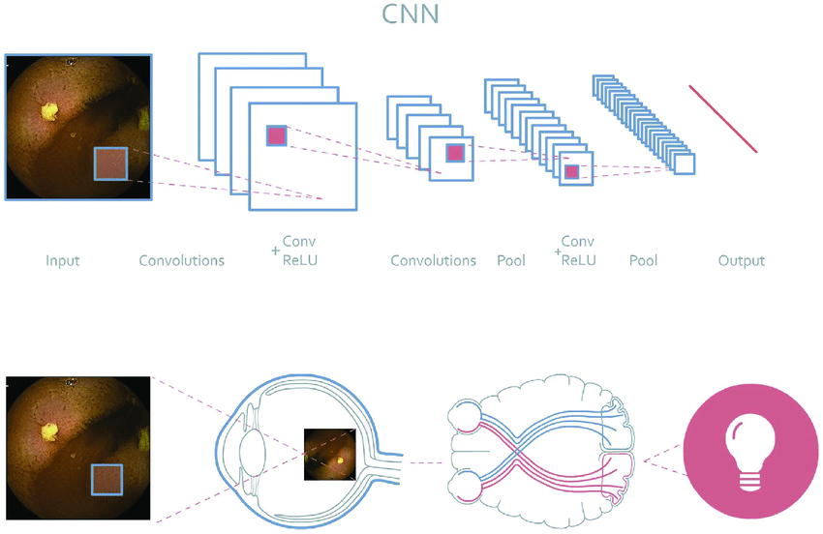
CNN | Visual Cortex
Convolutional Neural Networks are a special type of feed-forward artificial neural network in which the connectivity pattern between its neuron is inspired by the visual cortex.

Slide 5
Convolutional neural network
Convolutional neural network (CNN/ConvNet) is a class of deep neural networks, most commonly applied to analyze visual imagery
It uses a special technique called Convolution.

Slide 6
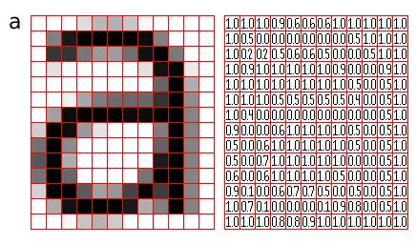
How Images are Stored in a Computer?
The image is divided up into a rectangular grid of pixels, so that each pixel is itself a small rectangle.
Once this has been done, each pixel is given a pixel value that represents the color of that pixel.

Slide 7
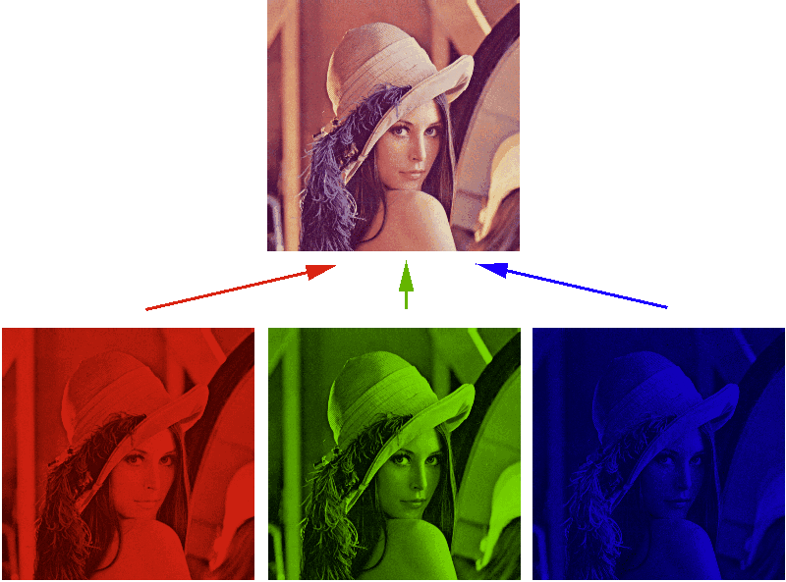
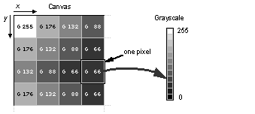
Grayscale / Binary Image

Slide 8
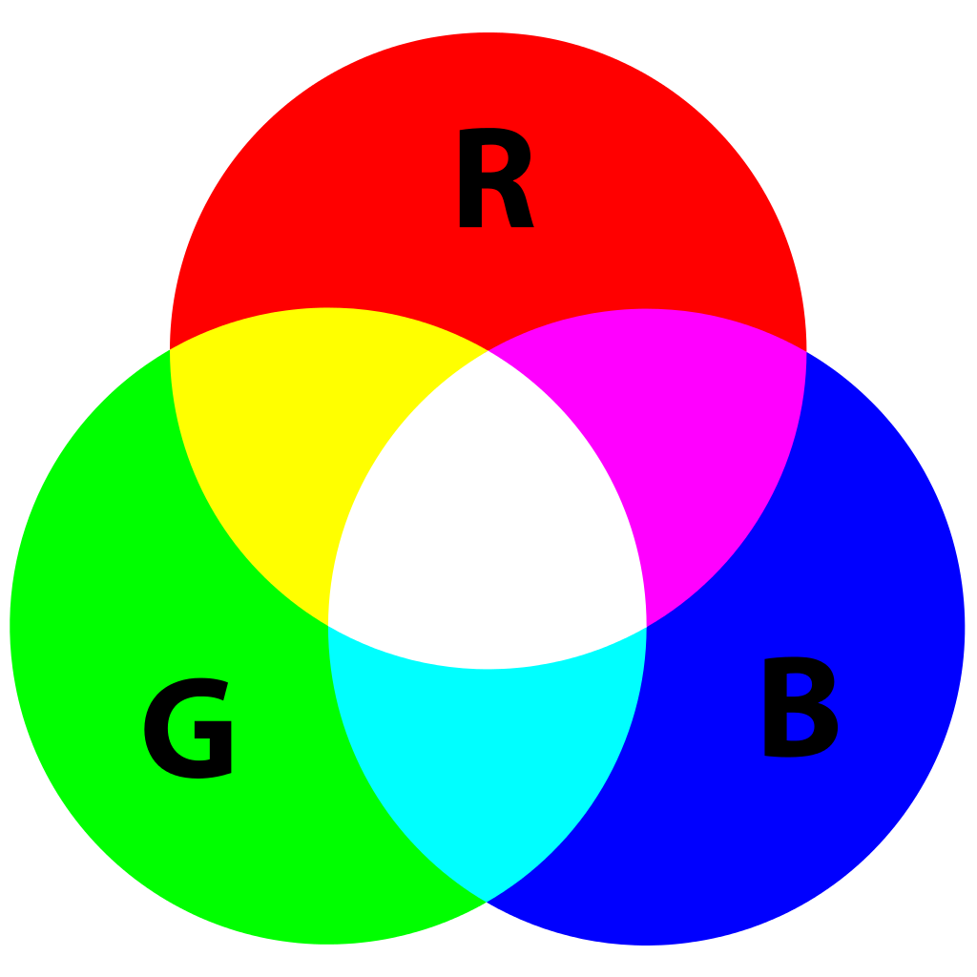
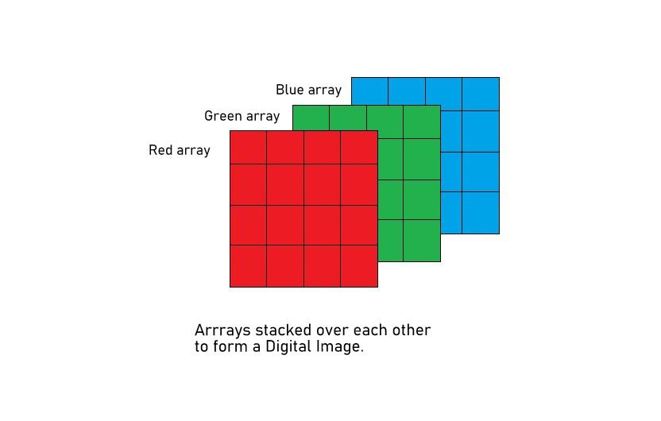
RGB Image

Slide 9
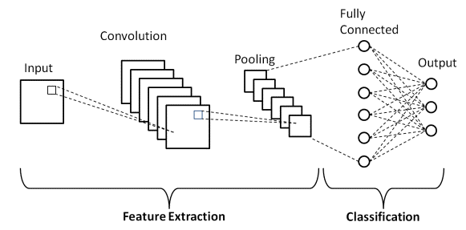
CNN architecture
Convolutional Neural Network consists of multiple layers like Input layer
Convolutional layer
Pooling layer
Fully Connected layers.

Slide 10
CNN architecture
Convolutional layer applies filters to the input image to extract features
Pooling layer downsamples the image to reduce computation
Fully Connected layer makes the final prediction.
The network learns the optimal filters through backpropagation and gradient descent.

Slide 11
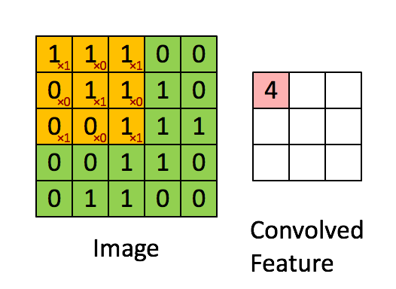
How does Convolution works?
1
1
1
0
1
1
1
0
1
0
0
1
0
1
0
1
0
1
Kernel
For ease of understanding let’s take a grayscale image

Slide 12
How does Convolution works?
1
1
1
We take a filter/kernel(3×3 matrix).
Apply it to the input image to get the convolved feature.
This convolved feature is passed on to the next layer.
0
1
1
1
0
1
0
0
1
0
1
0
1
0
1
Kernel

Slide 13
How does Convolution works?
1x1 + 1x0 + 1x1

Slide 14
How does Convolution works?
1x1 + 1x0 + 1x1 +
0x0 + 1x1 + 1x0

Slide 15
How does Convolution works?
1x1 + 1x0 + 1x1 +
0x0 + 1x1 + 1x0 +
0x1 + 0x0 + 1x1

Slide 16
How does Convolution works?
1x1 + 1x0 + 1x1 +
0x0 + 1x1 + 1x0 +
0x1 + 0x0 + 1x1
4

Slide 17
How does Convolution works?
1x1 + 1x0 + 1x1 +
0x0 + 1x1 + 1x0 +
0x1 + 0x0 + 1x1
4

Slide 18
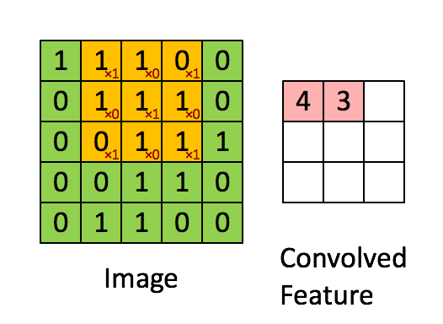
How does Convolution works?

Slide 19
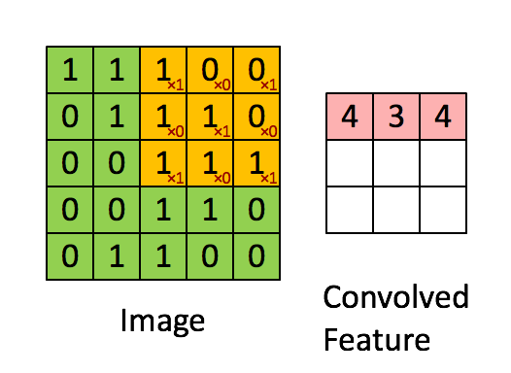
How does Convolution works?

Slide 20
How does Convolution works?

Slide 21
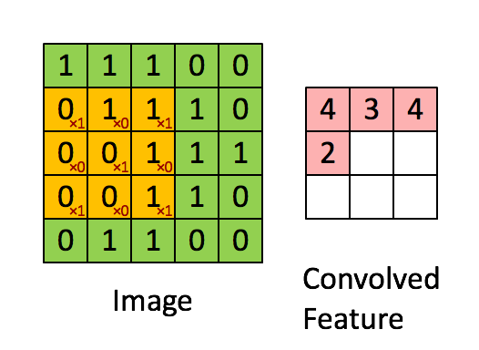
How does Convolution works?

Slide 22
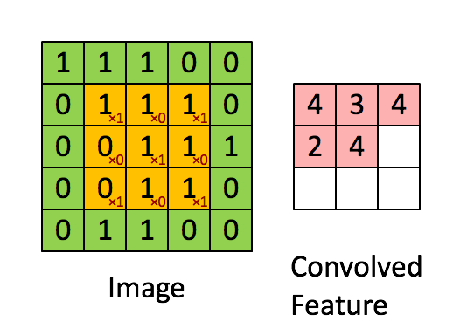
How does Convolution works?

Slide 23
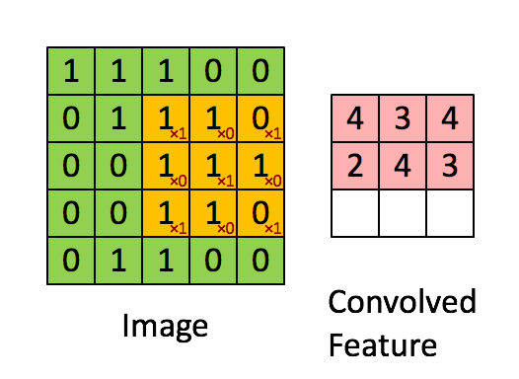
How does Convolution works?

Slide 24
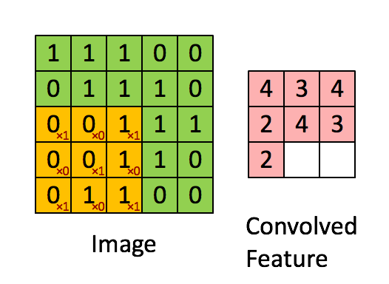
How does Convolution works?

Slide 25
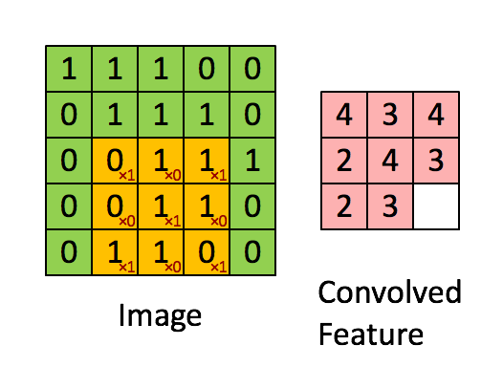
How does Convolution works?

Slide 26
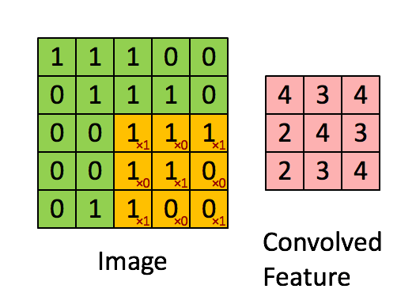
How does Convolution works?

Slide 27
How does Convolution works?

Slide 28
How does Convolution works?
In the case of a RGB image

Slide 29
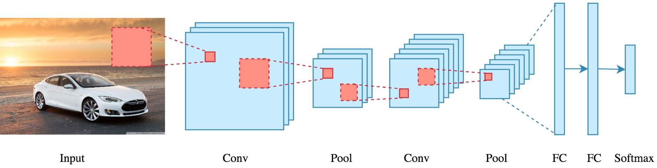
How does Convolution works?

Slide 30
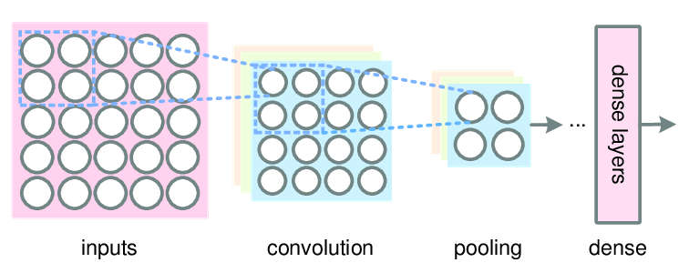
Pooling Layer
Similar to the Convolutional Layer, the Pooling layer is responsible for reducing the spatial size of the Convolved Feature.

Slide 31
Pooling Layer
Similar to the Convolutional Layer, the Pooling layer is responsible for reducing the spatial size of the Convolved Feature.
This is to decrease the computational power required to process the data by reducing the dimensions.

Slide 32
Pooling Layer
Similar to the Convolutional Layer, the Pooling layer is responsible for reducing the spatial size of the Convolved Feature.
This is to decrease the computational power required to process the data by reducing the dimensions.
There are (generally) two types of pooling - average pooling and max pooling.

Slide 33
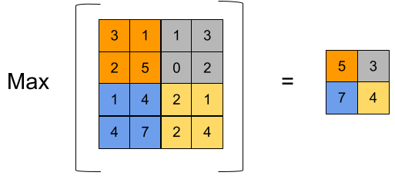
Max Pooling
We find the maximum value of a pixel from a portion of the image covered by the kernel.
Max Pooling also performs as a Noise Suppressant. It discards the noisy activations altogether and also performs de-noising along with dimensionality reduction.

Slide 34
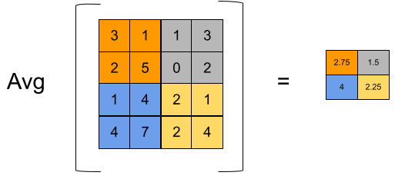
Max Pooling
Average Pooling returns the average of all the values from the portion of the image covered by the Kernel.

Slide 35
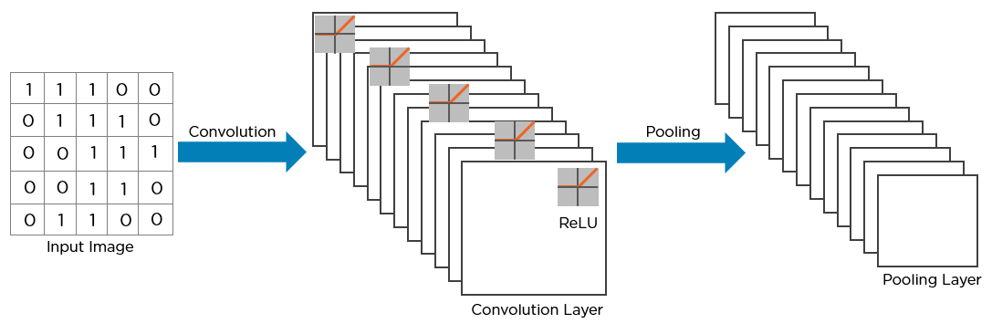
Here’s how the structure of the convolution neural network looks so far

Slide 36
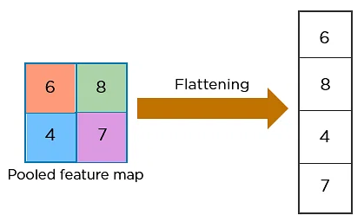
The next step in the process is called Flattening.
Flattening is used to convert all the resultant 2-Dimensional arrays from pooled feature maps into a single long continuous linear vector.

Slide 37
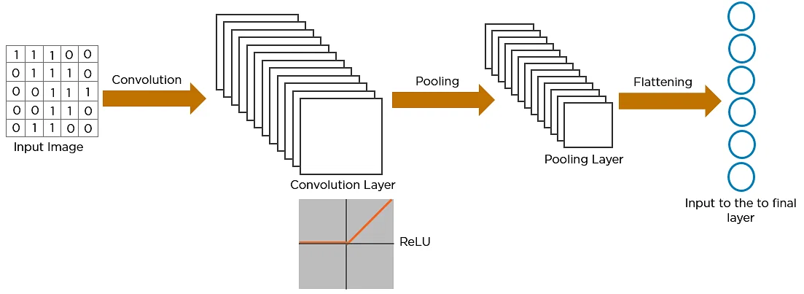
Flattening

Slide 38
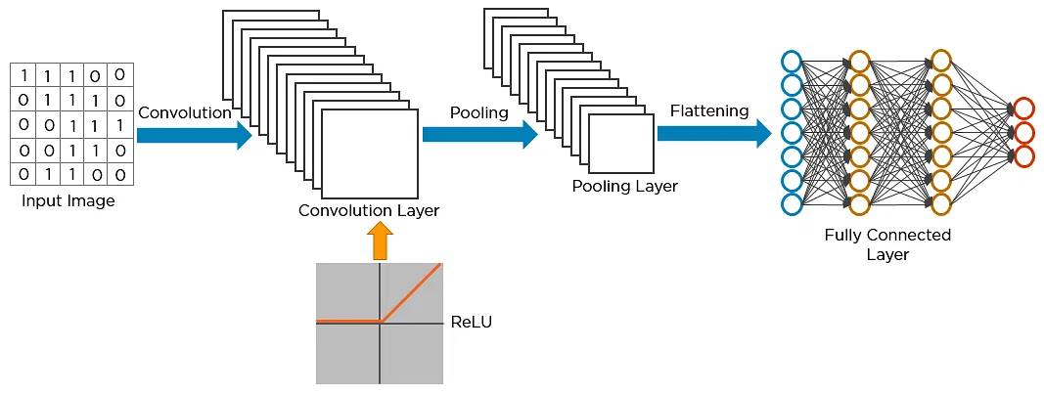
Fully Connected Layer

Slide 39
Non-Linearity - ReLU
For any kind of neural network to be powerful, it needs to contain non-linearity.
We pass the result of the convolution operation through relu activation function.

Slide 40
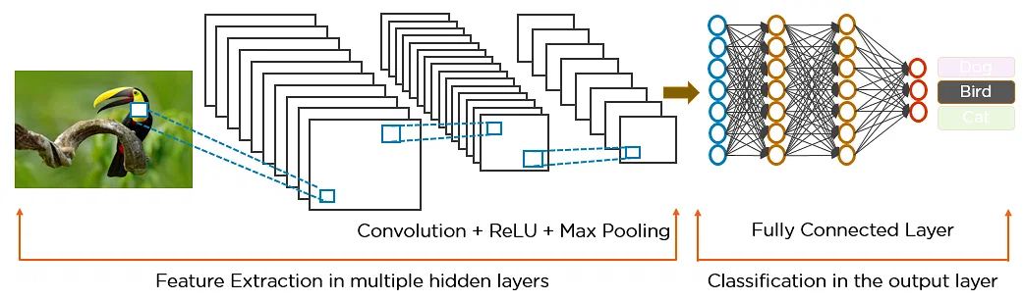
CNN Pipeline

Slide 41
More CNN Vocabulary - Stride
Stride specifies how much we move the convolution filter at each step.
By default the value is 1, as you can see in the figure below.

Slide 42
More CNN Vocabulary - Stride
We can have bigger strides if we want less overlap between the receptive fields. This also makes the resulting feature map smaller since we are skipping over potential locations.
The following figure demonstrates a stride of 2. Note that the feature map got smaller.

Slide 43
More CNN Vocabulary - Padding
We see that the size of the feature map is smaller than the input.
If we want to maintain the same dimensionality, we can use padding to surround the input with zeros.

Slide 44
Applications of CNN
Facial recognition
Medical imaging
Document analysis
Autonomous driving
Biometric authentication

Slide 45
Advantages of CNN
Efficient image processing
High accuracy rates
Robust to noise
Transfer learning
Automated feature extraction

Slide 46
Time for Hands On
Get Colab notebook from bit.ly/day12_notebook

